Slide 1


Shreyans
15-08-2023

Slide 2

Outline
Executive Summary
Introduction
Methodology
Results
Conclusion
Appendix

Slide 3
Executive Summary
Summary of methodologies
Data Collection through API and Web Scraping
Data Wrangling
Exploratory Data Analysis through SQL and Data Visualization
Interactive Visual Analytics from Folium
Machine Learning Prediction
Summary of all results
Exploratory Data Analysis Result
Interactive Analytics
Predictive Analysis

Slide 4
Introduction
SpaceX is a revolutionary company who has disrupt the space industry by offering a
rocket launches specifically Falcon 9 as low as 62 million dollars; while other providers
cost upward of 165 million dollar each. Most of this saving thanks to SpaceX
astounding idea to reuse the first stage of the launch by re-land the rocket to be used
on the next mission. Repeating this process will make the price down even further. As a
data scientist of a startup rivaling SpaceX, the goal of this project is to create the
machine learning pipeline to predict the landing outcome of the first stage in the future.
This project is crucial in identifying the right price to bid against SpaceX for a rocket
launch.
The problems included:
• Identifying all factors that influence the landing outcome.
• The relationship between each variables and how it is affecting the outcome.
• The best condition needed to increase the probability of successful landing.

Slide 5

Section 1

Slide 6
Methodology
Executive Summary
Data collection methodology:
I used SpaceX REST API and Wikipedia Web Scraped Data.
Perform data wrangling
I used One-Hot-Encoding for categorical Variables
Perform exploratory data analysis (EDA) using visualization and SQL
Perform interactive visual analytics using Folium and Plotly Dash
Perform predictive analysis using classification models

Slide 7
Data Collection
Data collection is the process of gathering and measuring information on targeted variables in an established system, which then enables one to answer relevant questions and evaluate outcomes. As mentioned, the dataset was collected by REST API and Web Scrapping from Wikipedia
For REST API, its started by using the get request. Then, we decoded the response content as Json and turn it into a pandas data frame using json_normalize(). We then cleaned the data, checked for missing values and fill with whatever needed.
For web scrapping, we will use the BeautifulSoup to extract the launch records as HTML table, parse the table and convert it to a pandas data frame for further analysis

Slide 8
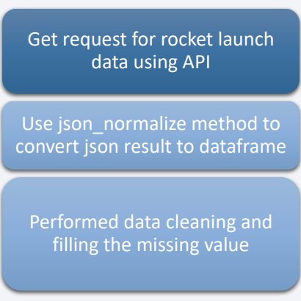
Data Collection – SpaceX API
Present your data collection with SpaceX REST calls using key phrases and flowcharts
https://github.com/mehtashreyans3602/IBM-Data-Science-Capestone/blob/main/notebook_Data_Collection_yJPxhv2oU.ipynb

Slide 9
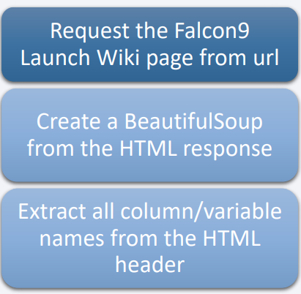
Data Collection - Scraping
Present your web scraping process using key phrases and flowcharts
https://github.com/mehtashreyans3602/IBM-Data-Science-Capestone/blob/main/notebook_Data_Collection_with_Web_Scraping_nI89VIRCE.ipynb

Slide 10
Data Wrangling
https://github.com/mehtashreyans3602/IBM-Data-Science-Capestone/blob/main/notebook_Data_Wrangling_9HnvfsJ5G.ipynb
Data Wrangling is the process of cleaning and
unifying messy and complex data sets for easy access
and Exploratory Data Analysis (EDA).
We will first calculate the number of launches on each
site, then calculate the number and occurrence of
mission outcome per orbit type.
We then create a landing outcome label from the
outcome column. This will make it easier for further
analysis, visualization, and ML. Lastly, we will export
the result to a CSV

Slide 11
EDA with Data Visualization
We first started by using scatter graph to find the relationship between the attributes such as between:
Payload and Flight Number.
Flight Number and Launch Site.
Payload and Launch Site.
Flight Number and Orbit Type.
Payload and Orbit Type.
Once a pattern is determined from the graphs. It’s very easy to see which factors affecting the most to the success of the landing outcomes. Bar graphs Attribute to that. To see the Trend we use the Line Chart, here we use it to launch success trend.
https://github.com/mehtashreyans3602/IBM-Data-Science-Capestone/blob/main/notebook_Exploratory_Data_Analysis_with_Visualisation_Lab_jJkKVG6F1.ipynb

Slide 12
EDA with SQL
Using SQL, we had performed many queries to get better understanding of the dataset, Ex: - Displaying the names of the launch sites.
Displaying 5 records where launch sites begin with the string ‘CCA’.
Displaying the total payload mass carried by booster launched by NASA (CRS).
Displaying the average payload mass carried by booster version F9 v1.1.
Listing the date when the first successful landing outcome in ground pad was achieved.
Listing the names of the boosters which have success in drone ship and have payload mass greater than 4000 but less than 6000.
Listing the total number of successful and failure mission outcomes.
Listing the names of the booster_versions which have carried the maximum payload mass.
Listing the failed landing_outcomes in drone ship, their booster versions, and launch sites names for in year 2015.
Rank the count of landing outcomes or success between the date 2010-06-04 and 2017-03-20, in descending order

Slide 13
Build an Interactive Map with Folium
To visualize the launch data into an interactive map. We took the latitude and longitude coordinates at each launch site and added a circle marker around each launch site with a label of the name of the launch site.
I then assigned the data frame launch_outcomes(failure,success) to classes 0 and 1 with Red and Green markers on the map in MarkerCluster().
I then used the Haversine’s formula to calculated the distance of the launch sites to various landmark to find answer to the questions of:
• How close the launch sites with railways, highways and coastlines?
• How close the launch sites with nearby cities?
https://github.com/mehtashreyans3602/IBM-Data-Science-Capestone/blob/main/notebook_Interactive_Visual_Analytics_with_Folium_M8uUhCmHY.ipynb

Slide 14
Build a Dashboard with Plotly Dash
We built an interactive dashboard with Plotly dash which allowing the user to play around with the data as they need.
We plotted pie charts showing the total launches by a certain sites.
We then plotted scatter graph showing the relationship with Outcome and Payload Mass (Kg) for the different booster version.
https://github.com/mehtashreyans3602/IBM-Data-Science-Capestone/blob/main/SpacexDash.py

Slide 15
Predictive Analysis (Classification)
Build the Model
Evaluate the Model
Improve the Model
Find the Best Fit Model
https://github.com/mehtashreyans3602/IBM-Data-Science-Capestone/blob/main/SpacexDash.py

Slide 16
Results
Exploratory data analysis results
Interactive analytics demo in screenshots
Predictive analysis results

Slide 17

Section 2

Slide 18
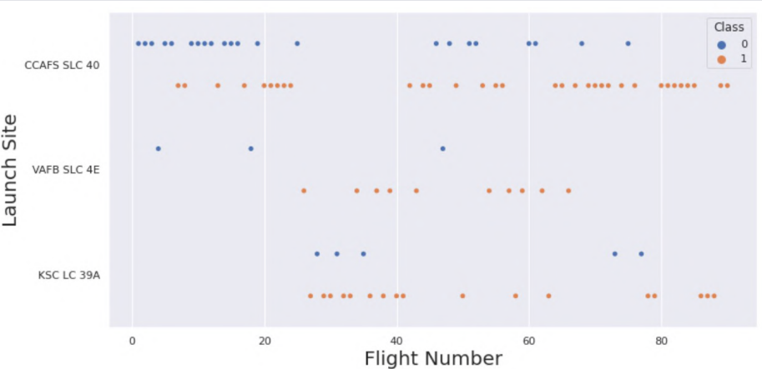
Flight Number vs. Launch Site
This scatter plot
shows that the larger
the flights amount
of the launch site,
the greater the
success rate will be.
However, site CCAFS
SLC40 shows the
least pattern of this.

Slide 19
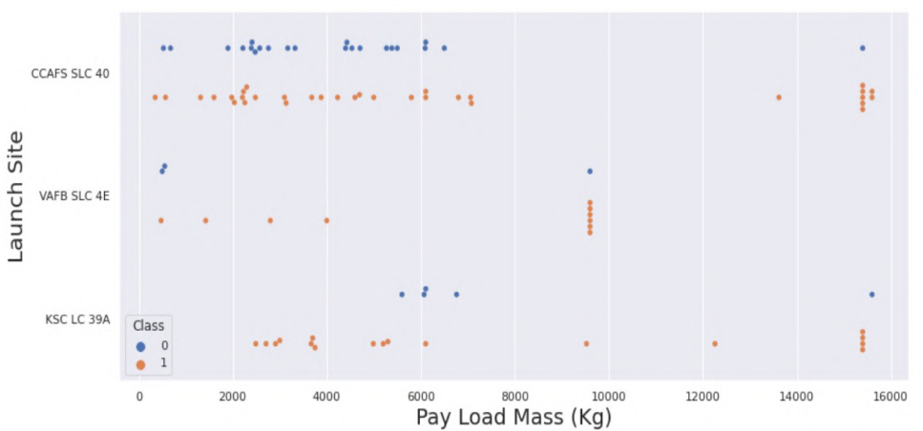
Payload vs. Launch Site
This scatter plot shows
once the pay load mass is
greater than 7000kg, the
probability of the success
rate will be highly
increased.
However, there is no clear
pattern to say the launch
site is dependent to the pay
load mass for the success
rate.

Slide 20
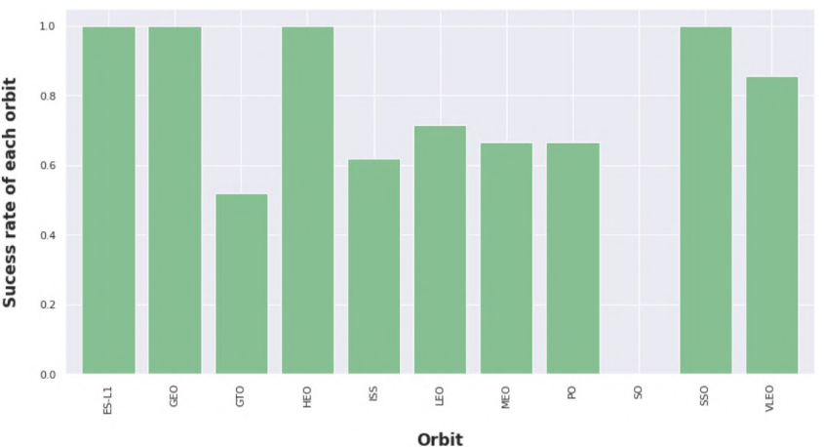
Success Rate vs. Orbit Type
This figure depicted the possibility of the orbits to influences the landing outcomes as some orbits has 100% success rate such as SSO, HEO, GEO AND ES-L1 while SO orbit produced 0% rate of success.
However, deeper analysis show that some of this orbits has only 1 occurrence such as GEO, SO, HEO and ES-L1 which mean this data need more dataset to see pattern or trend before we draw any conclusion.

Slide 21
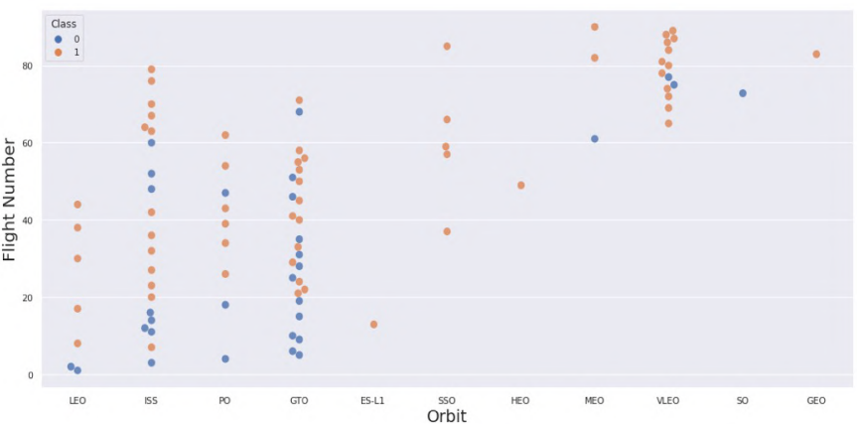
Flight Number vs. Orbit Type
This scatter plot shows that
generally, the larger the flight
number on each orbits, the
greater the success rate
(especially LEO orbit) except for
GTO orbit which depicts no
relationship between both
attributes.
Orbit that only has 1 occurrence
should also be excluded from
above statement as it’s needed
more dataset.

Slide 22
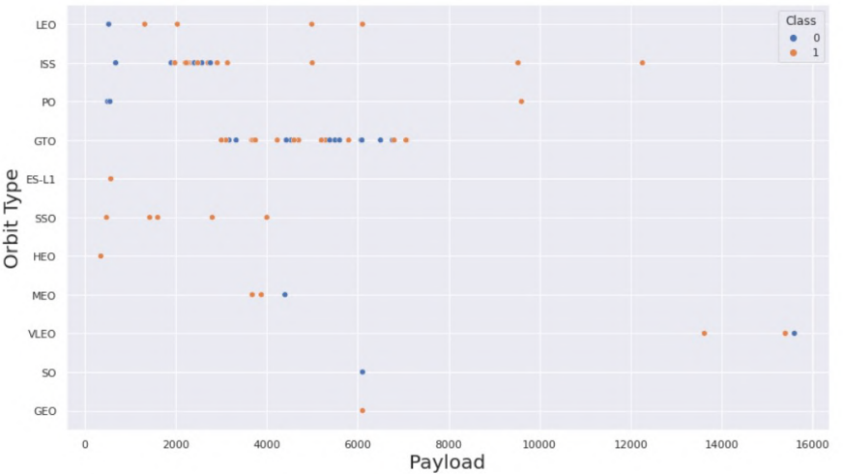
Payload vs. Orbit Type
Heavier payload has positive
impact on LEO, ISS and P0 orbit.
However, it has negative impact
on MEO and VLEO orbit.
GTO orbit seem to depict no
relation between the attributes.
Meanwhile, again, SO, GEO and
HEO orbit need more dataset to
see any pattern or trend.

Slide 23
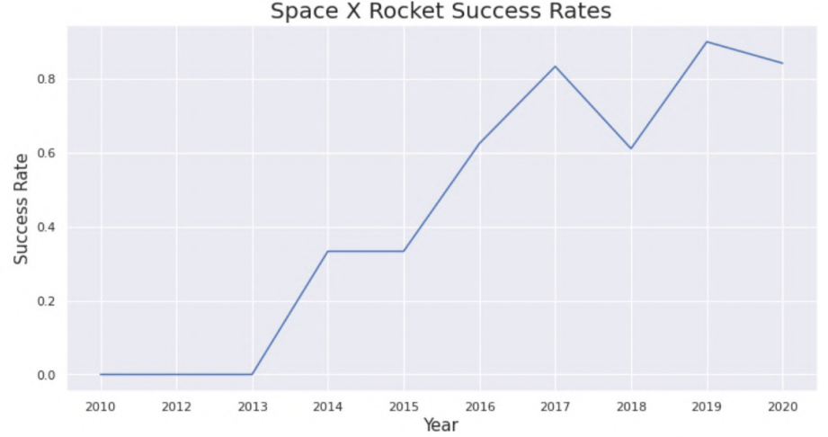
Launch Success Yearly Trend
This figures clearly depicted and increasing trend from the year 2013 until 2020. If this trend continue for the next year onward. The success rate will steadily increase until reaching 1/100% success rate.

Slide 24
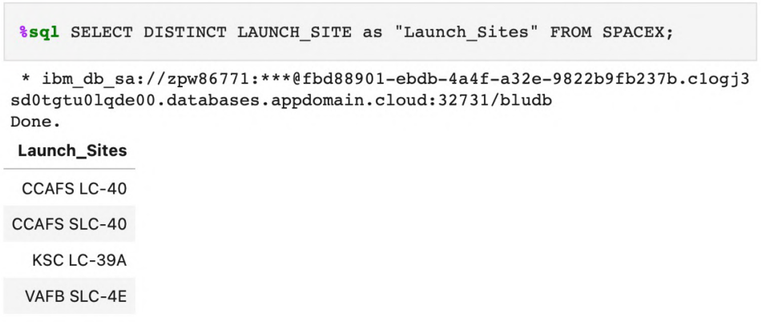
All Launch Site Names
I have used DISTINCT Keyword to filter out the Launch Site Names here.

Slide 25
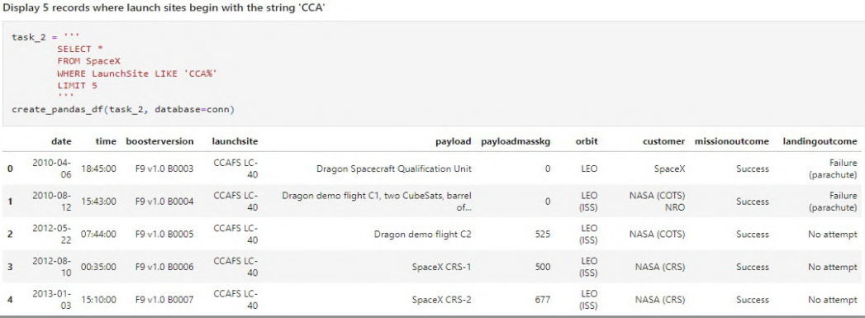
Launch Site Names Begin with 'CCA'
I have used the LIKE to display 5 records where launch sites begin with `CCA`

Slide 26
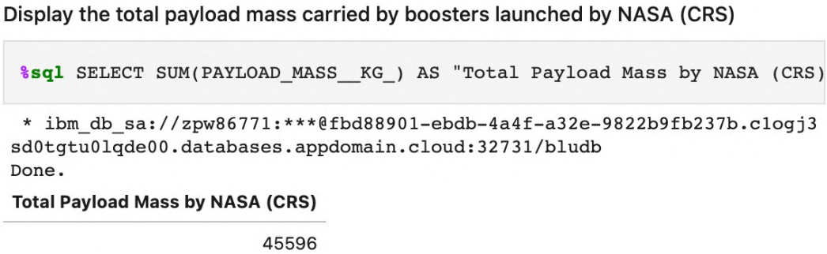
Total Payload Mass
I have calculated the total payload carried by boosters from NASA as 45596 using the query below

Slide 27
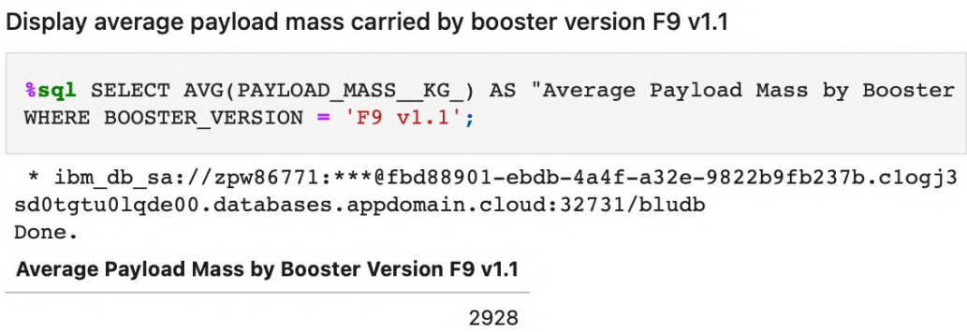
Average Payload Mass by F9 v1.1
I have calculated the average payload mass carried by booster version
F9 v1.1 as 2928.4

Slide 28
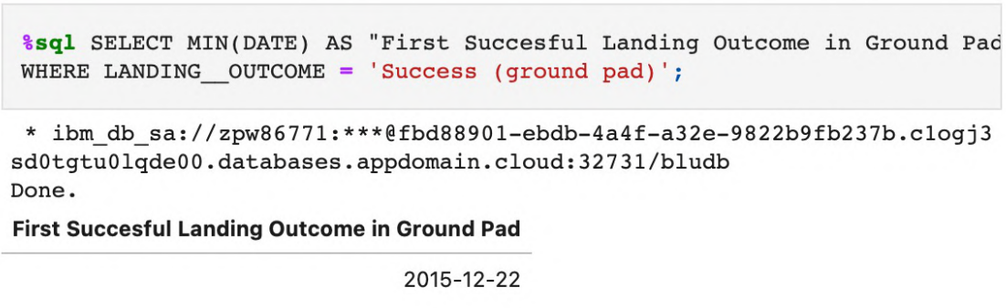
First Successful Ground Landing Date
I have used the min() function to find the result. We observed that the dates of the first successful landing outcome on ground pad was 22nd December 2015

Slide 29
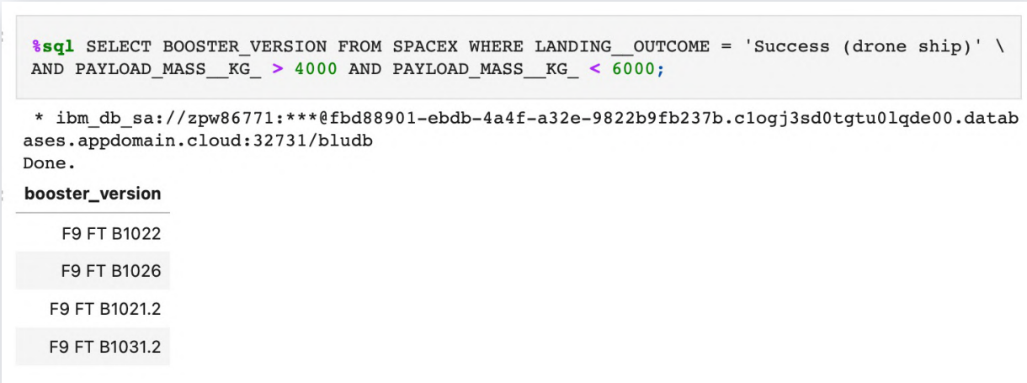
Successful Drone Ship Landing with Payload between 4000 and 6000
I used the WHERE clause to filter for boosters which have successfully landed on drone ship and applied the AND condition to determine successful landing with payload mass greater than 4000 but less than 6000

Slide 30
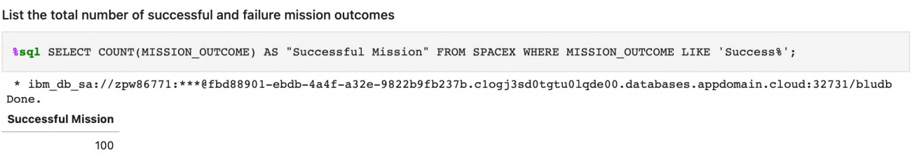
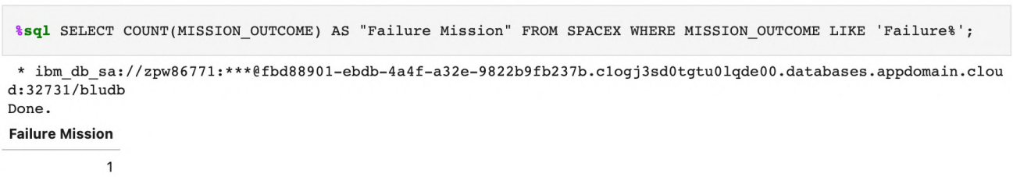
Total Number of Successful and Failure Mission Outcomes
I used wildcard like ‘%’ to filter for WHERE Mission Outcome was a success or a failure.

Slide 31
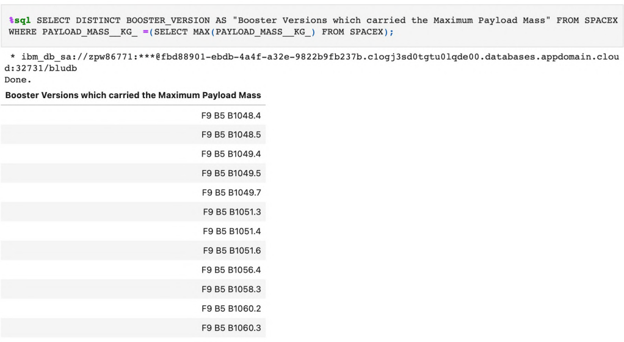
Boosters Carried Maximum Payload
I determined the booster that have carried the maximum payload using a subquery in the WHERE clause and the MAX() function

Slide 32
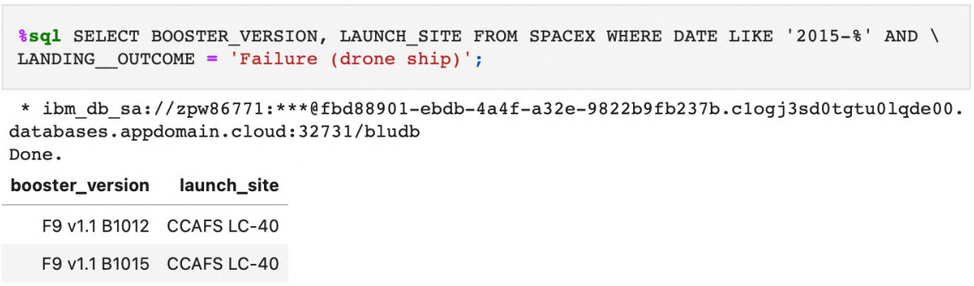
2015 Launch Records
I used a combinations of the WHERE clause, LIKE, AND, and BETWEEN conditions to filter for failed landing outcomes in drone ship, their booster versions, and launch site names for year 2015.

Slide 33
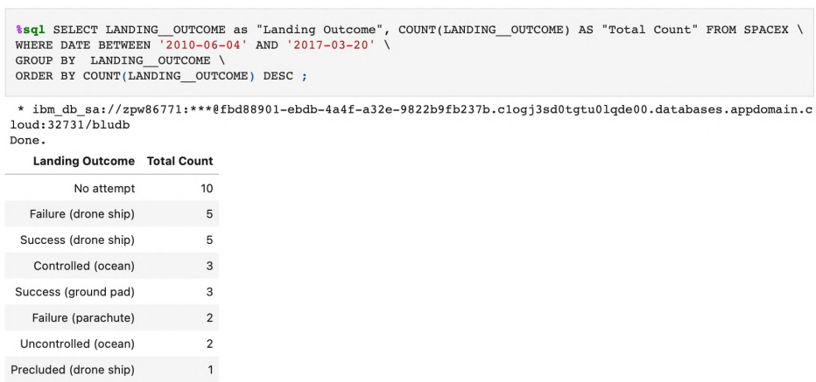
Rank Landing Outcomes Between 2010-06-04 and 2017-03-20
We selected Landing outcomes and the COUNT of landing outcomes from the data and used the WHERE clause to filter for landing outcomes BETWEEN 2010-06-04 to 2010-03-20.
We applied the GROUP BY clause to group the landing outcomes and the ORDER BY clause to order the grouped landing outcome in descending order.

Slide 34

Section 3

Slide 35
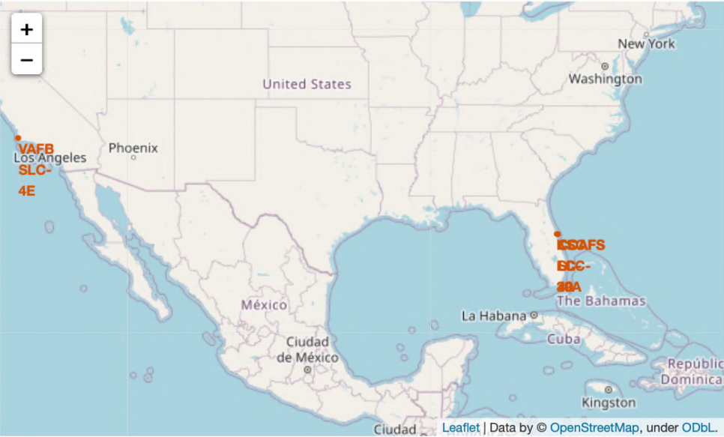
Site Locations in USA

Slide 36
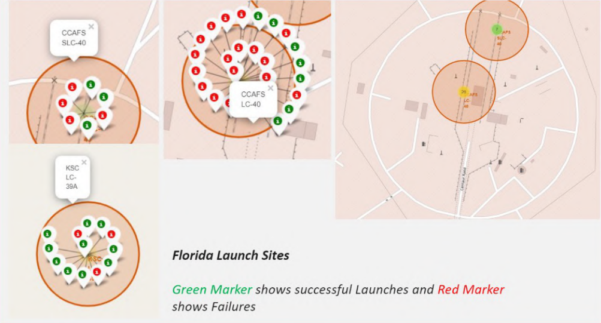
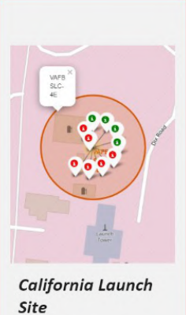
Markers showing launch sites with color labels

Slide 37
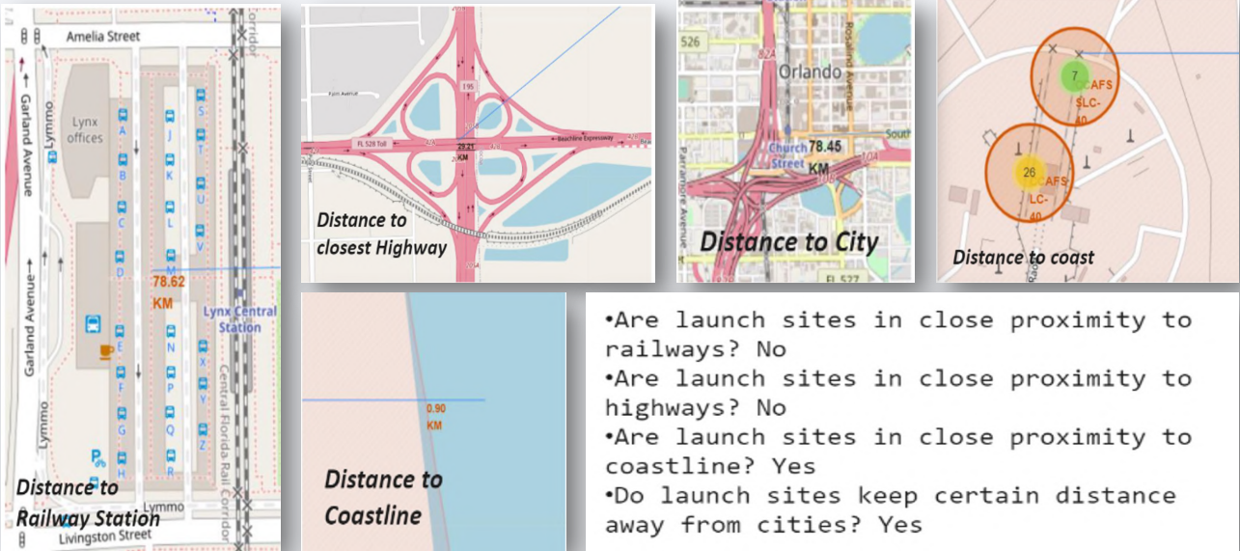
Launch Sites Distance to Landmarks

Slide 38

Section 4

Slide 39
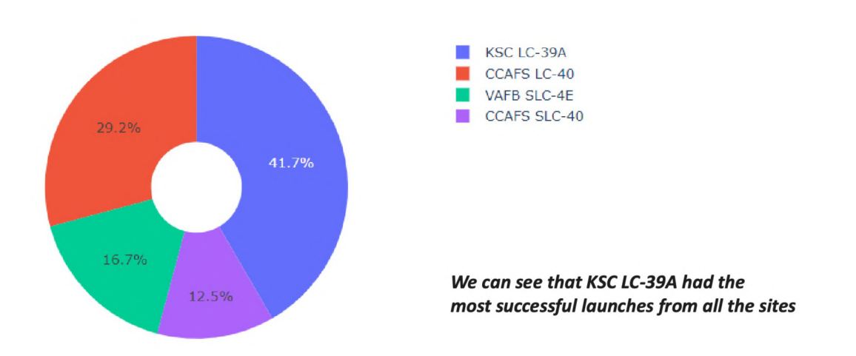
Success Percentage of Each Site

Slide 40
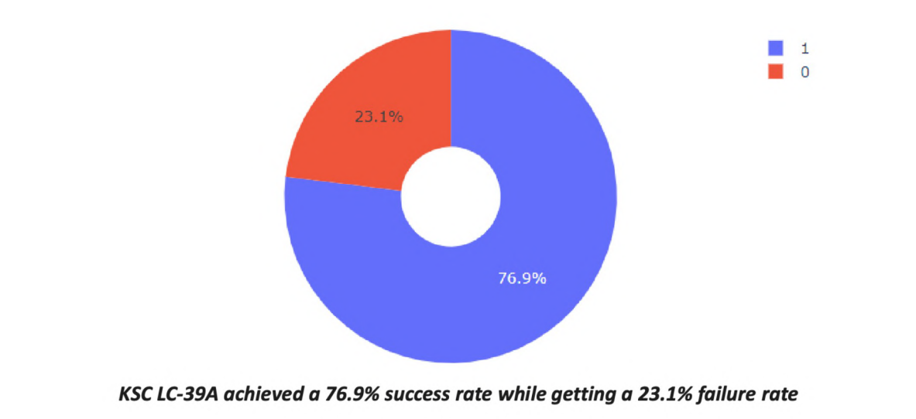
Highest Launch Success Ratio

Slide 41
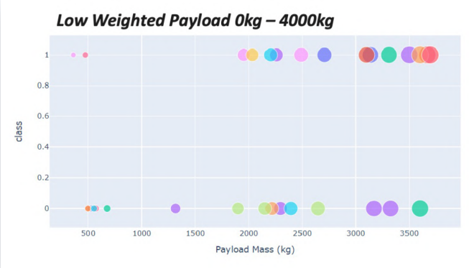
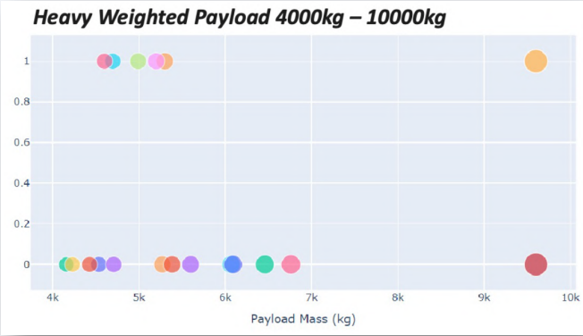
Payload vs Launch Outcome Scatter Plot
We can see that all the success rate for low weighted payload is higher than heavy weighted payload

Slide 42

Section 5

Slide 43
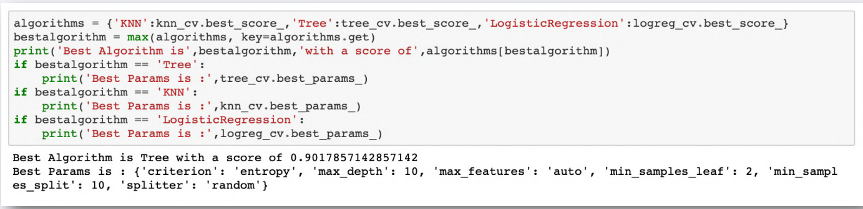
Classification Accuracy
As we can see, by using the code as below: we could identify that the best algorithm to be the Tree Algorithm which have the highest classification accuracy.

Slide 44
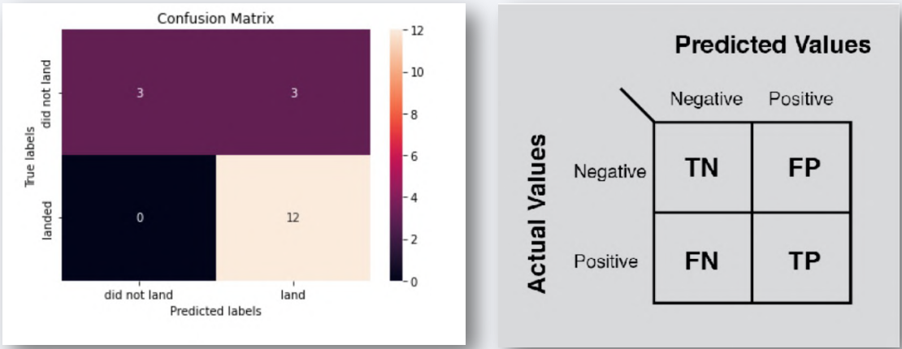
Confusion Matrix
The confusion matrix for the decision tree classifier shows that the classifier can distinguish between the different classes. The major problem is the false positives .i.e., unsuccessful landing marked as successful landing by the classifier.

Slide 45
Conclusions
I can conclude that:
The Tree Classifier Algorithm is the best Machine Learning approach for this dataset.
The low weighted payloads (which define as 4000kg and below) performed better than the heavy weighted payloads.
Starting from the year 2013, the success rate for SpaceX launches is increased, directly proportional time in years to 2020, which it will eventually perfect the launches in the future.
KSC LC-39A have the most successful launches of any sites; 76.9%
SSO orbit have the most success rate; 100% and more than 1 occurrence.

Slide 46


